Slide 1



Student Management System
Instructed By : Safin Ahmmed
Lecturer, Dept Of CSE ,KUET
Presented By:
1. Khalid Bin Atik 2307073
2. MD. Abdullahil Kafi 2307074
3. Pranto Ghosh 2307075
4. MD. Habibur Rahman 2307076
5. MD. Sibatullah Hosen Rafi 2307077

Slide 2
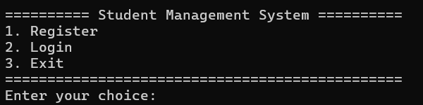
Quick overview of the project :
A console-based Student Management System
Supports three user roles: Student, Teacher, Admin
Manages user registration, login, and role-based dashboards
Handles student results with GPA calculation
Main Function Flow:
Creates Main Menu object and loads data from files
Loads students, teachers, and admins from text files
Initializes default admin if no admin exists
Displays main menu for registration, login, or exit

Slide 3
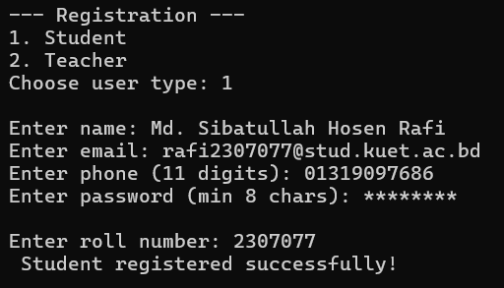
Students can:
Register with roll number, name, email, phone, and password
Login using roll number and password
View and edit their personal information
Change password securely
View their result (if assigned)

Slide 4
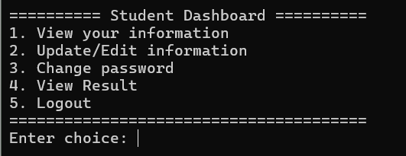
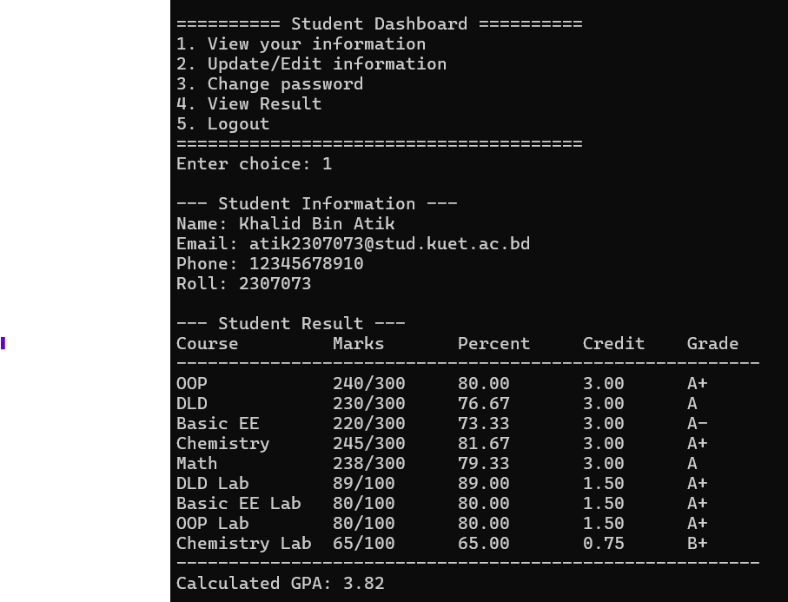
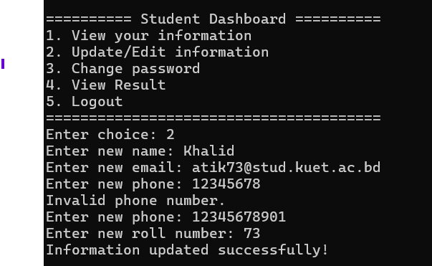

Slide 5
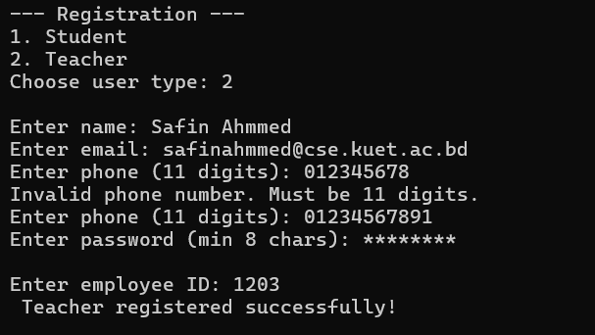
Teachers can:
Register with employee ID and personal details
Login using employee ID and password
View and edit their information
View all students
Search student by roll number
Assign or update marks for students

Slide 6
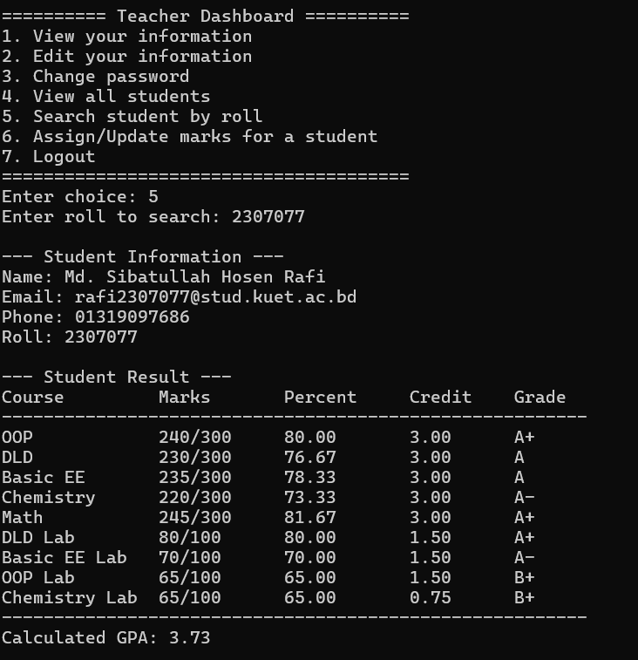
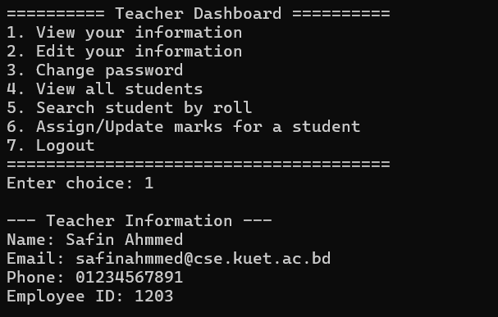

Slide 7
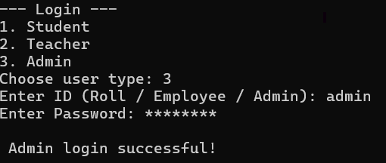
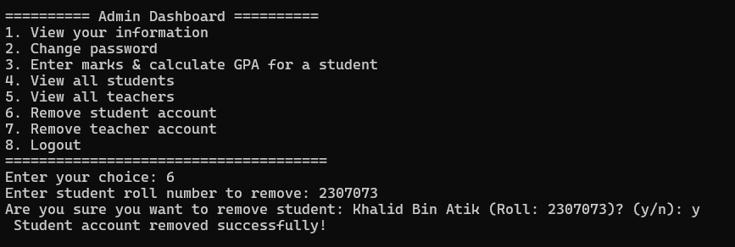
Admins can:
Login with admin ID and password
View and edit their information
Change password
Enter marks and calculate GPA for any student
View all students and teachers
Remove student or teacher accounts

Slide 8
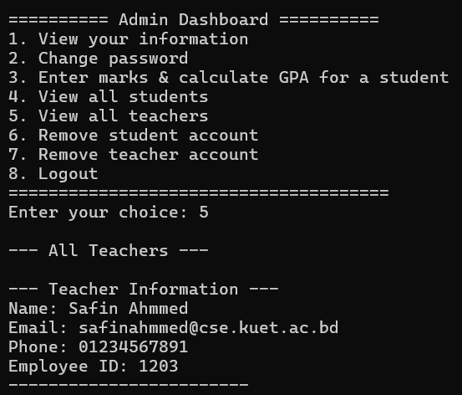
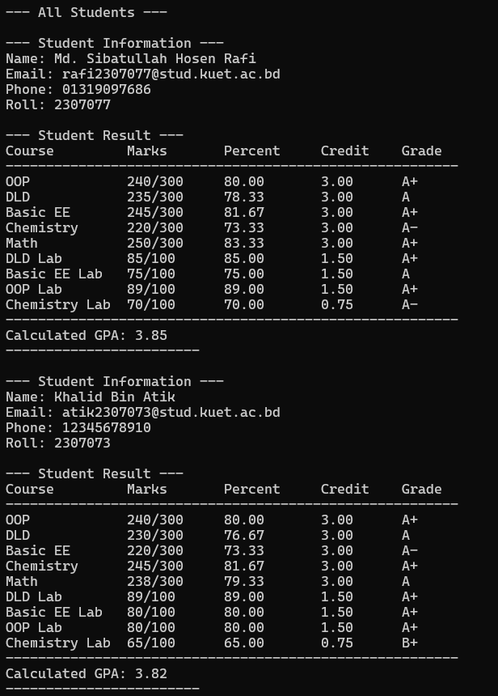

Slide 9
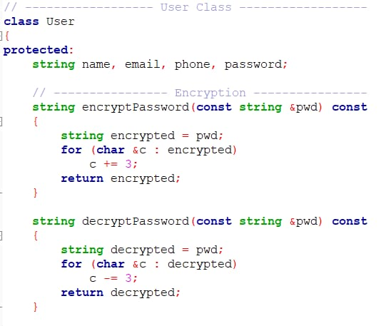
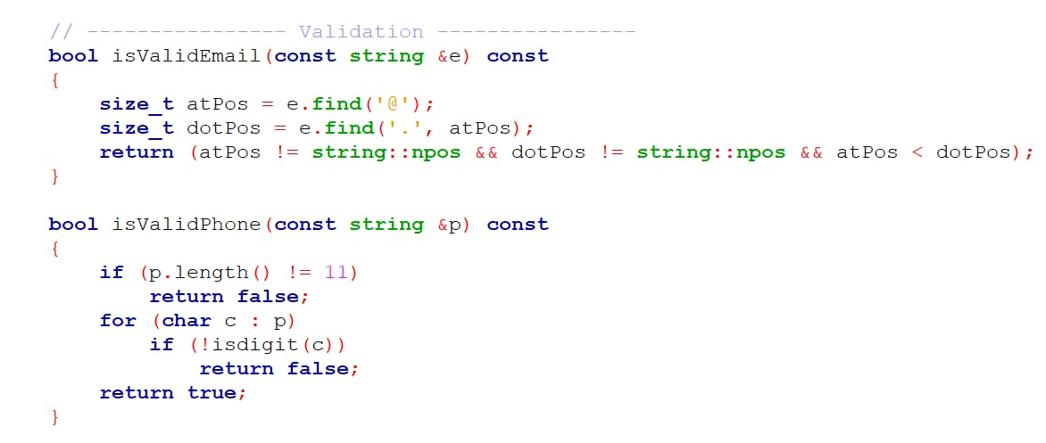
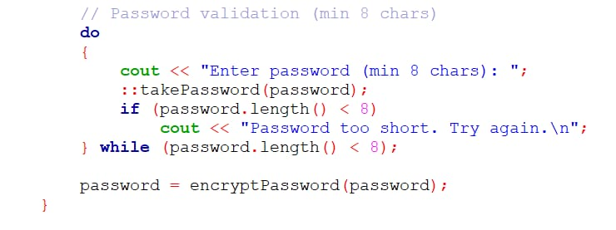
The User Class :
Handles:
Name
Email
Phone
Password (encrypted)
Features:
Virtual functions for input, display, and file I/O
Password encryption and decryption
Email and phone validation
Operator overloading for << and >>
Abstract method getID()

Slide 10
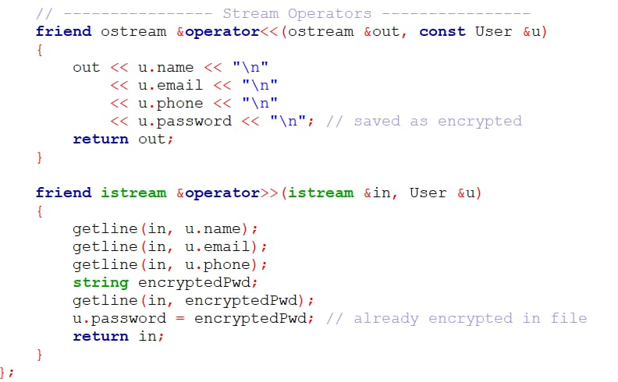
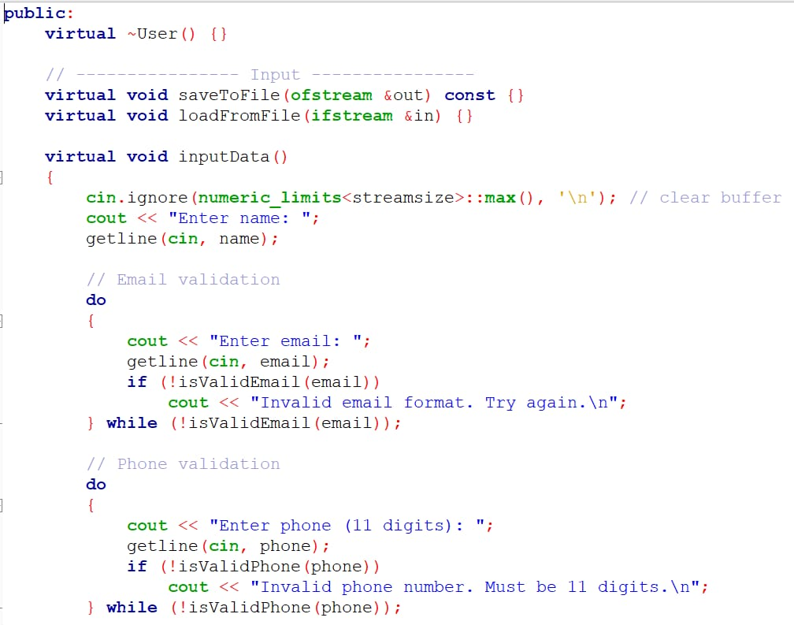
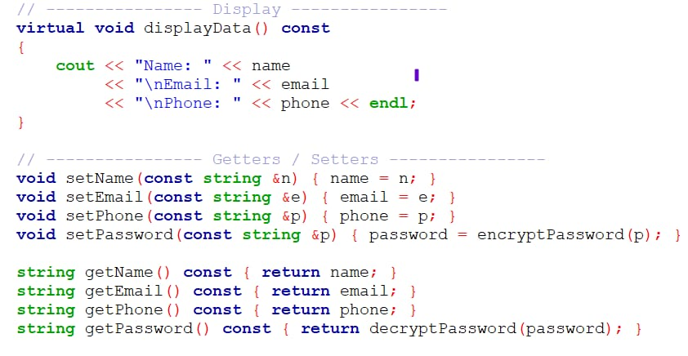
The User Class:

Slide 11
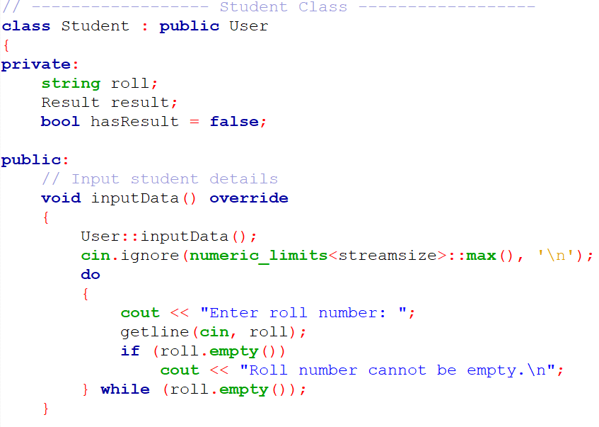
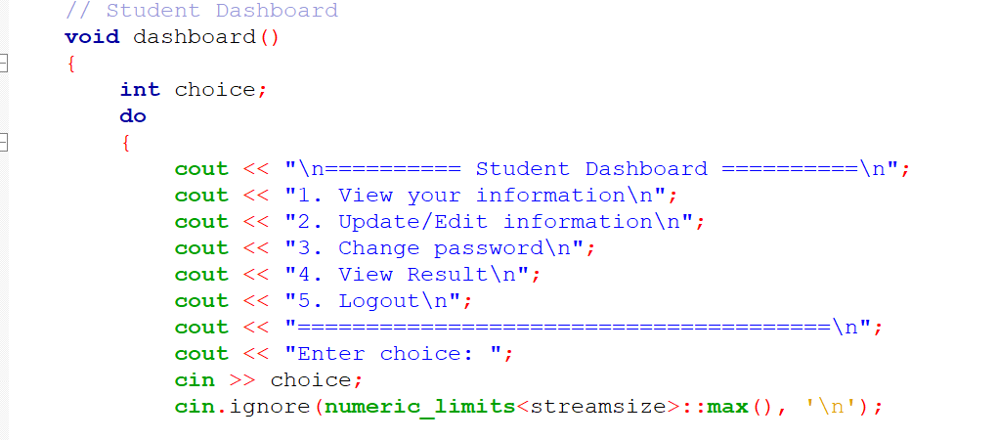
The Student Class (Inherits from User)
Handles:
Roll number
Result object
Result assignment status
Functions:
Input and display student data
Assign marks and calculate GPA
Dashboard for student operations
Save/load to/from file
Operator overloading: ==, <, <<

Slide 12
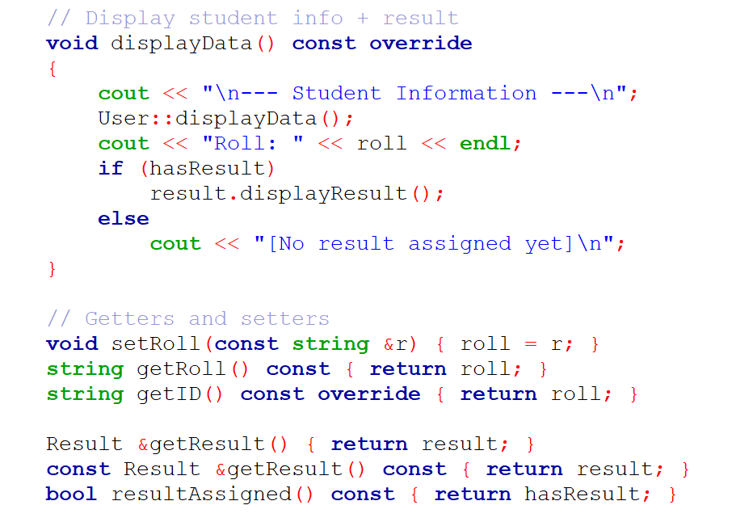
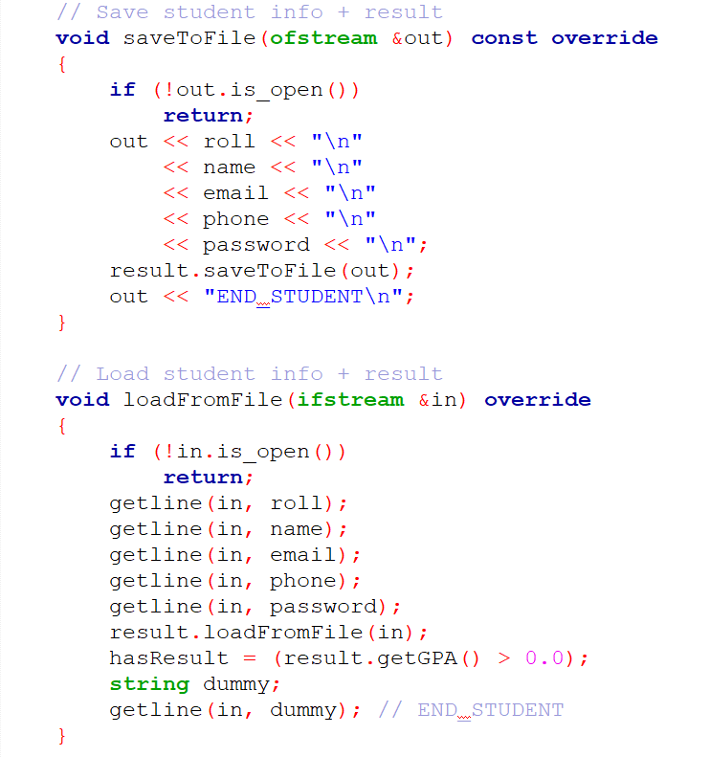
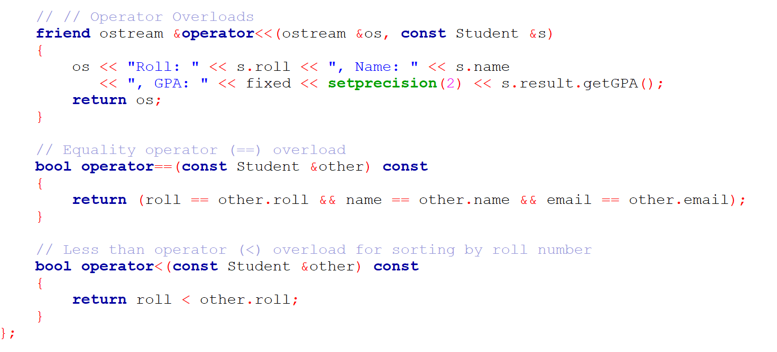
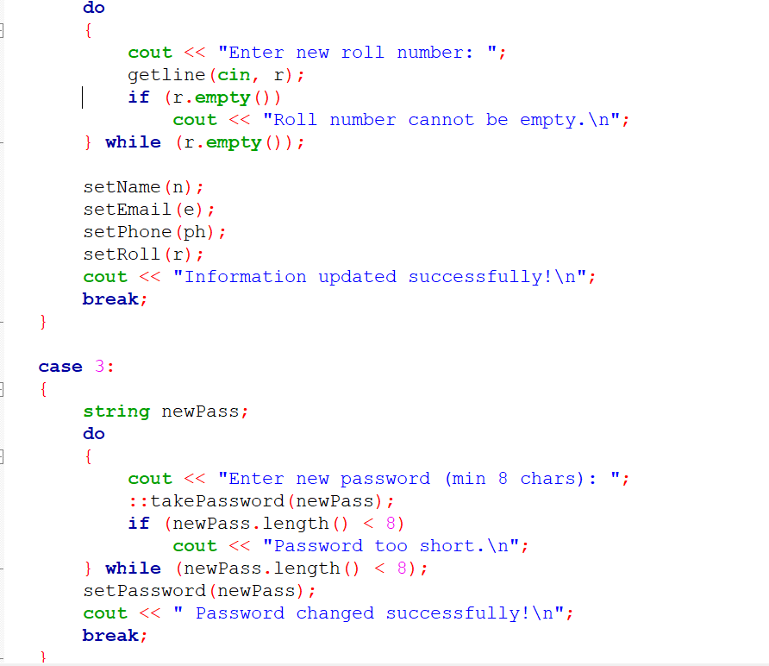
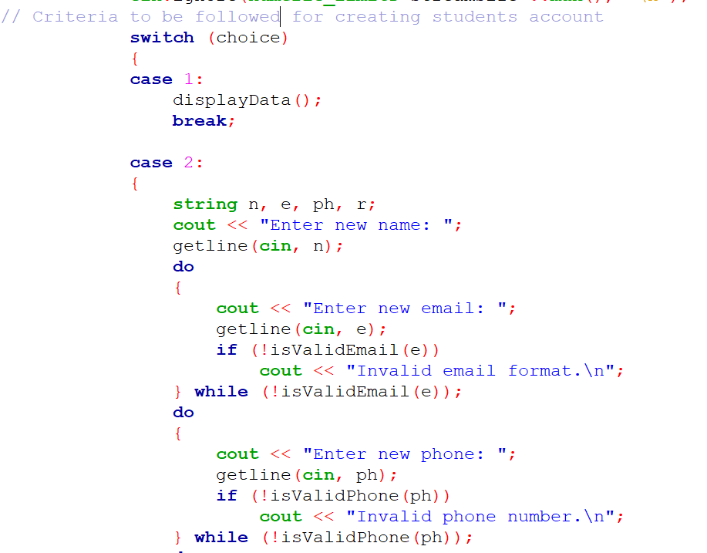
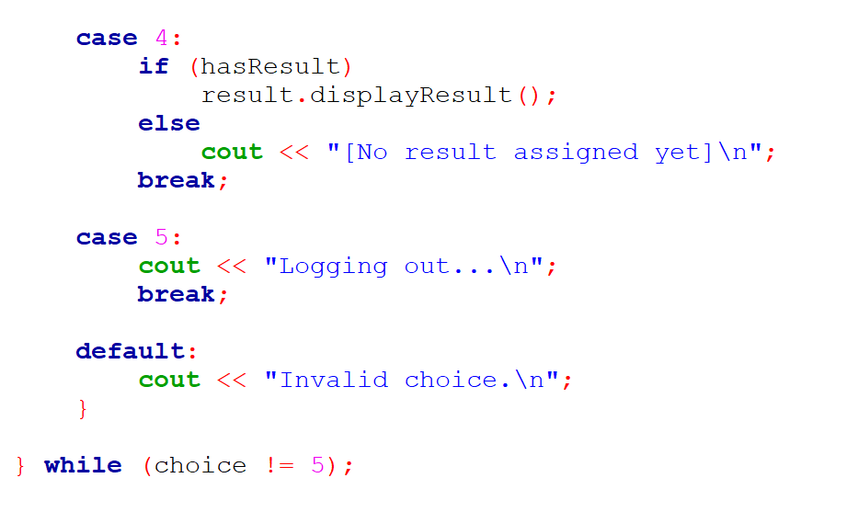

Slide 13
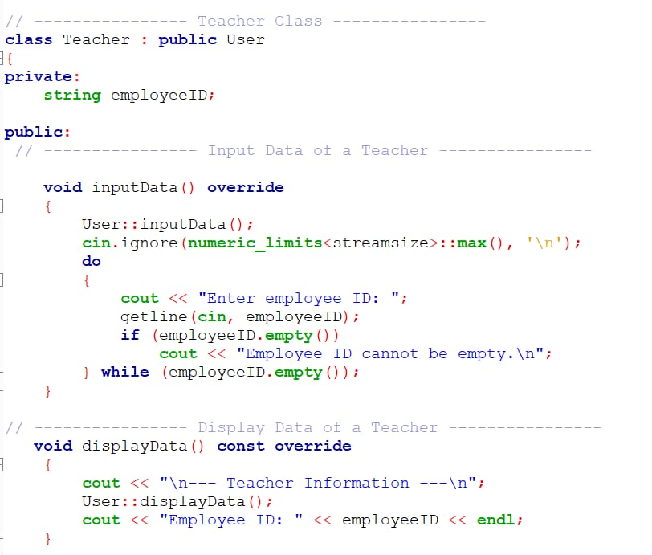
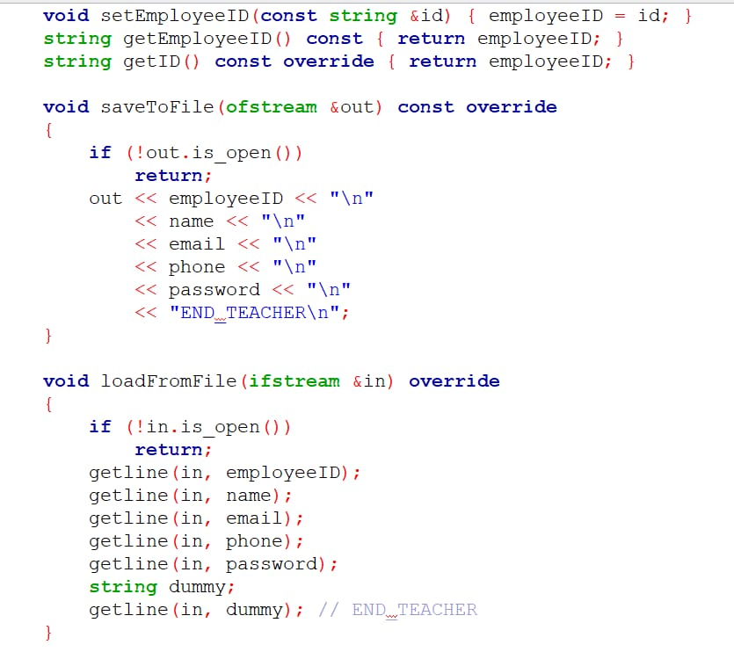
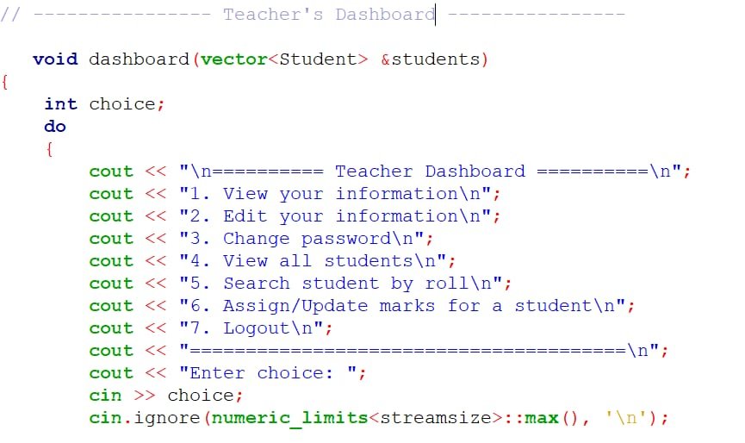
The Teacher Class (Inherits from User)
Handles:
Employee ID
Functions:
Input and display teacher data
Dashboard with student management
Search and assign marks to students
Operator overloading: ==, >, <<

Slide 14
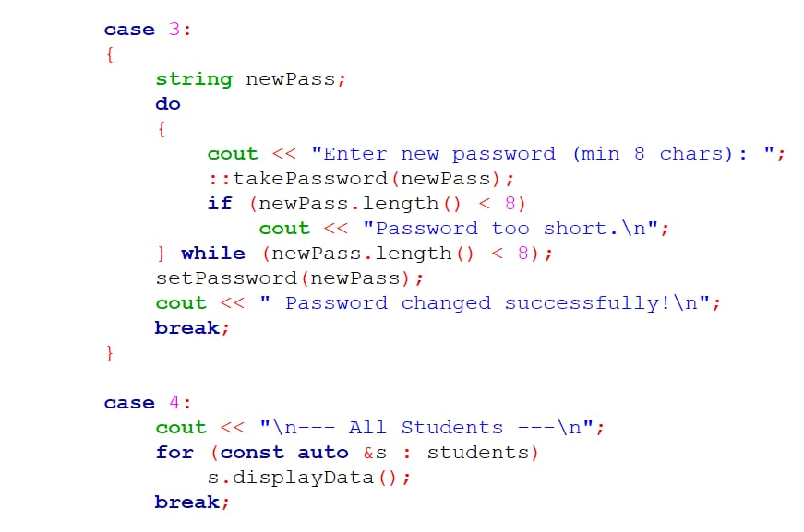
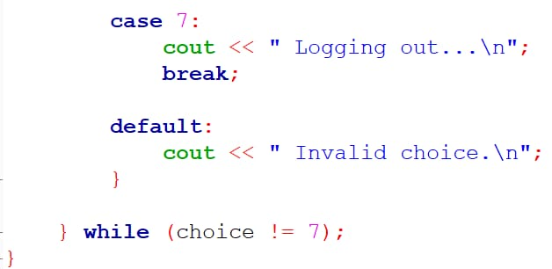
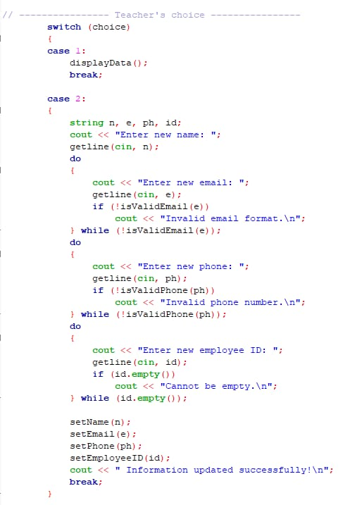
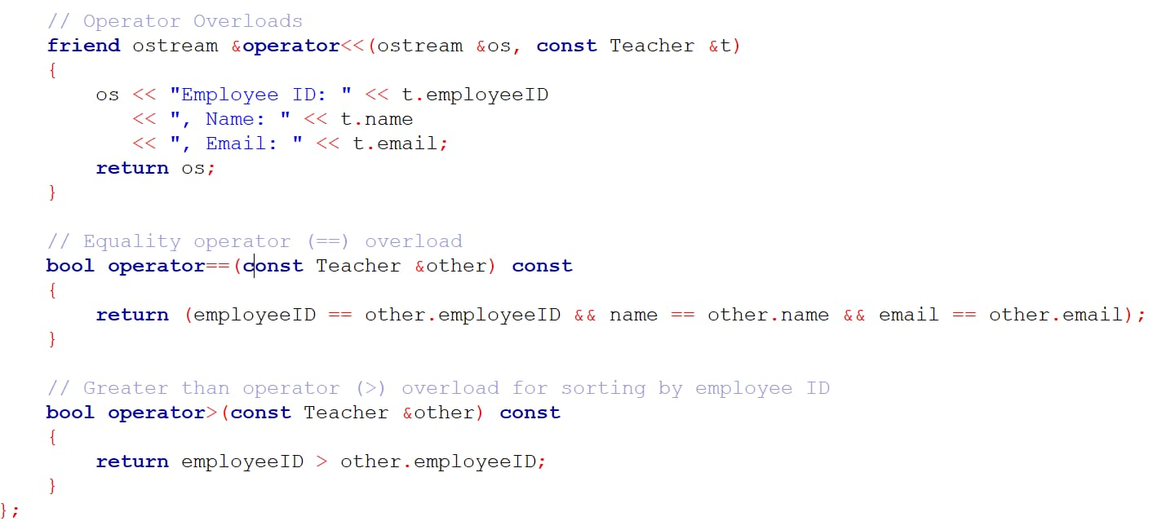
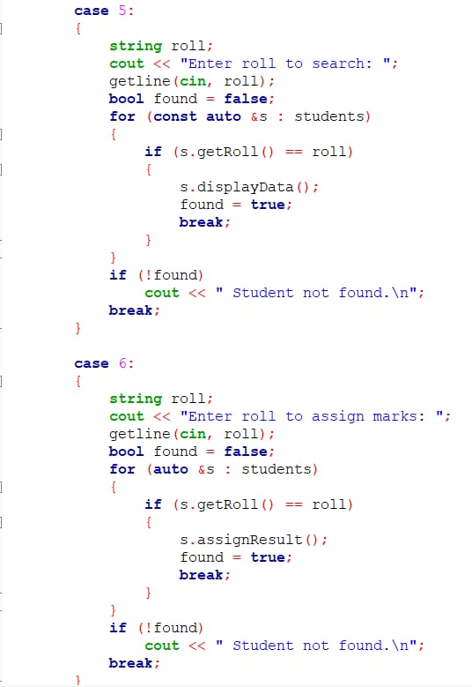
Teacher Class

Slide 15
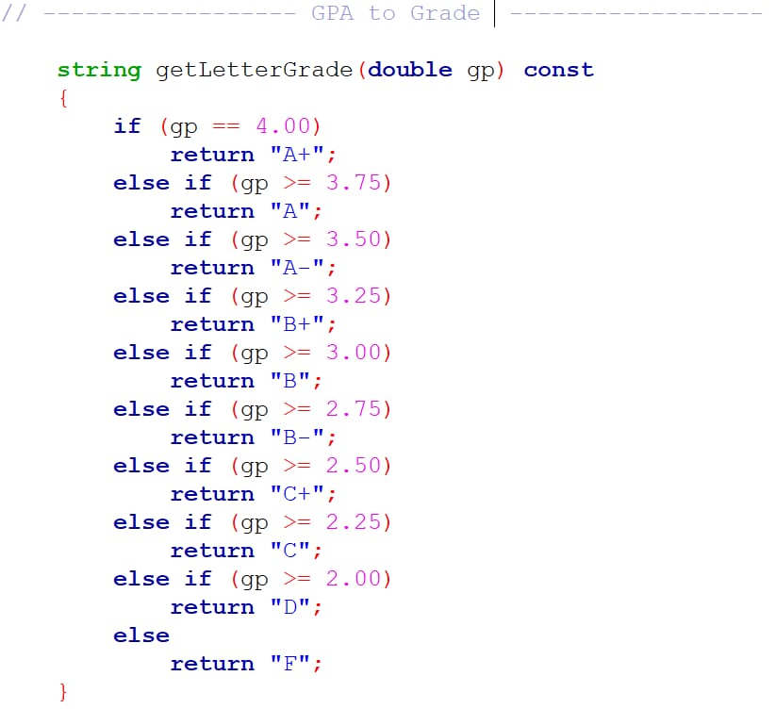
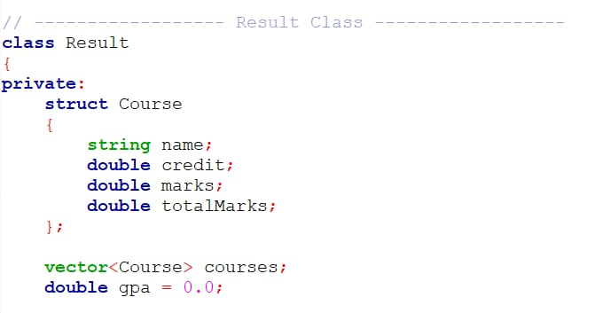
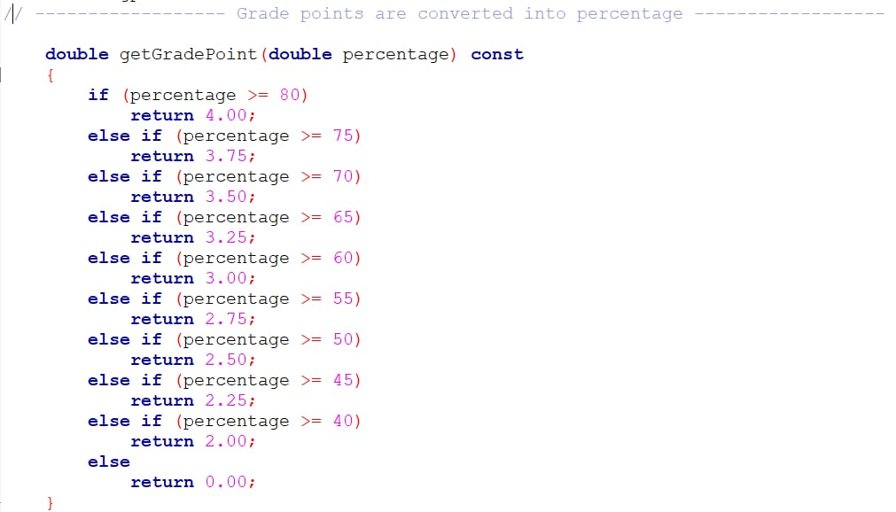
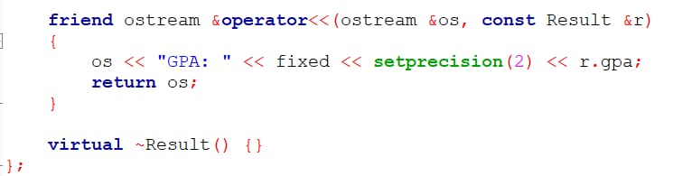
The Result Class :
Handles:
List of courses (name, credit, marks, total marks)
GPA calculation
Functions:
Input marks for each course
Calculate GPA and grade points
Display result in tabular form
Save/load result to/from file
Operator overloading: <<

Slide 16
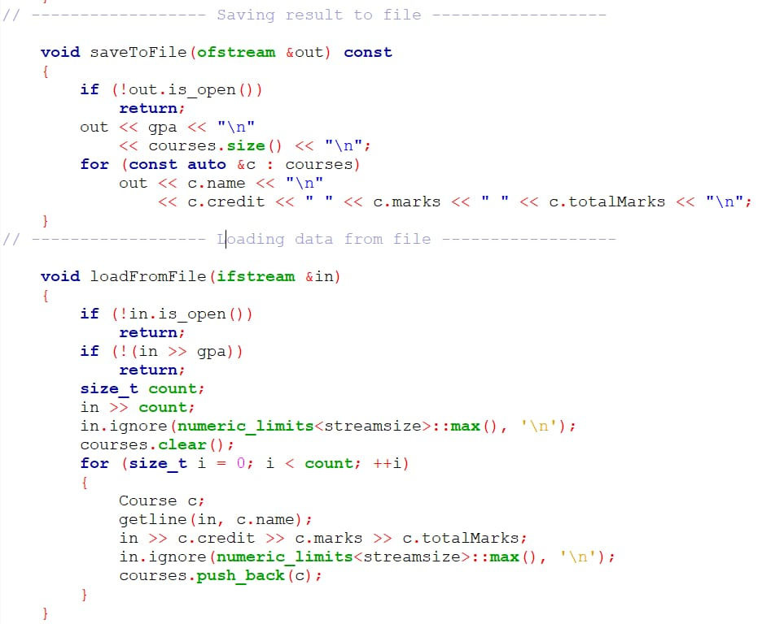
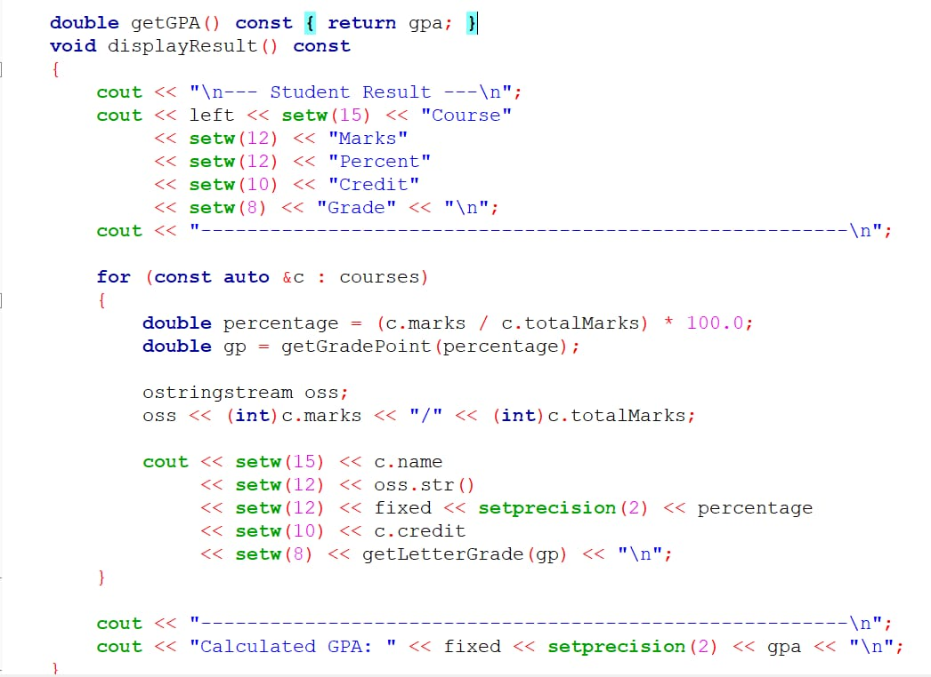
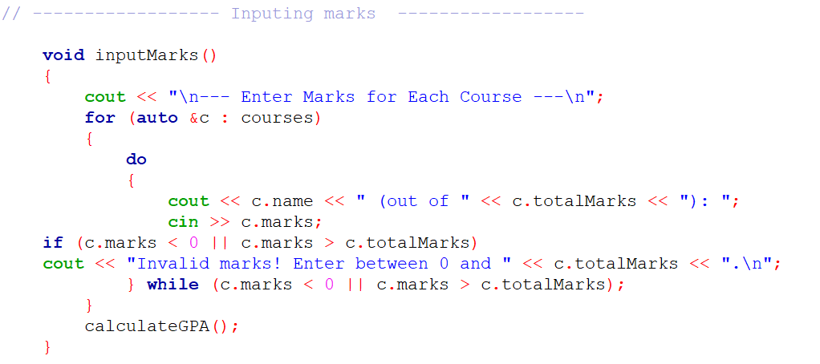
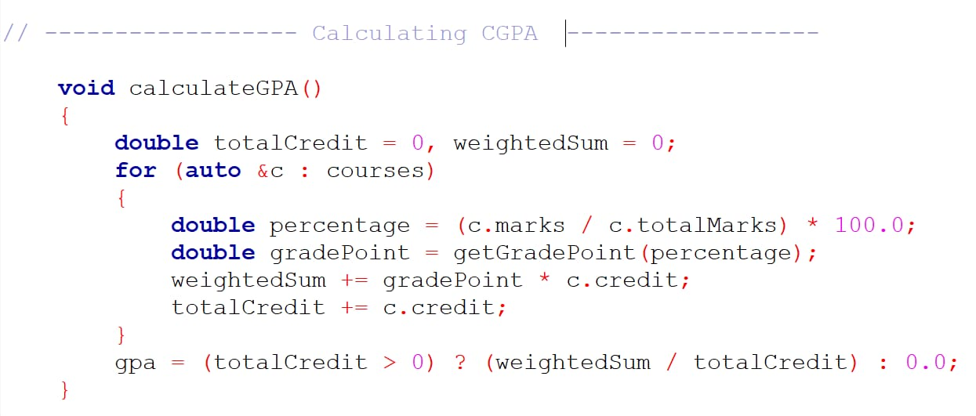
Result Class

Slide 17
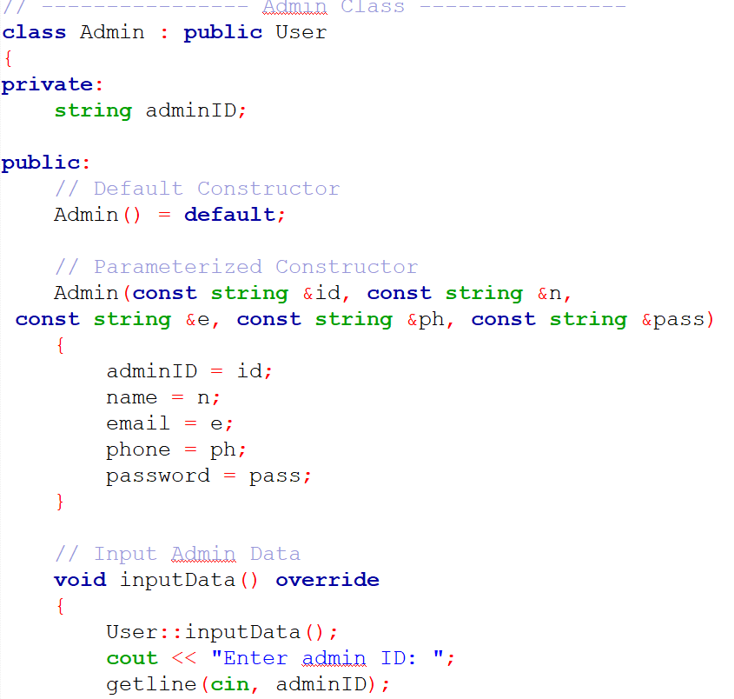
The Admin Class (Inherits from User)
Handles:
Admin ID
Functions:
Input and display admin data
Dashboard for system management
Remove student/teacher accounts
Operator overloading: ==, =, <<

Slide 18
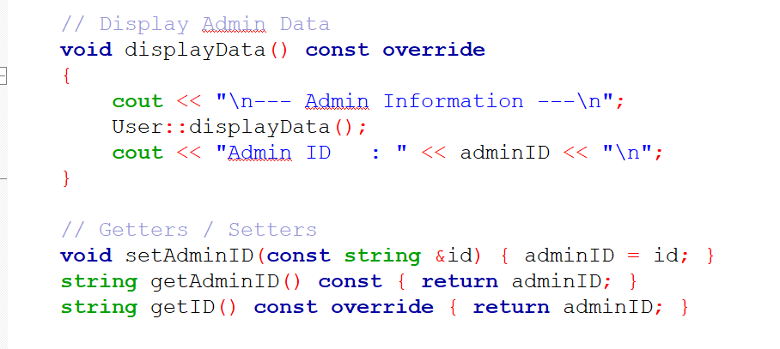
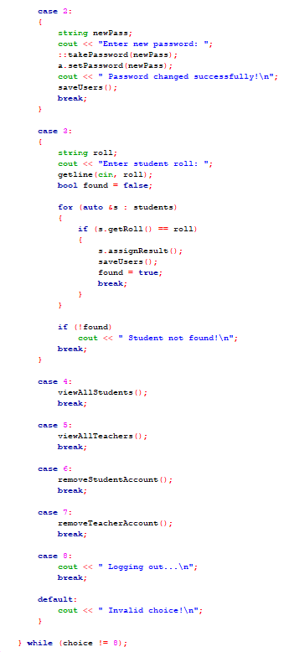
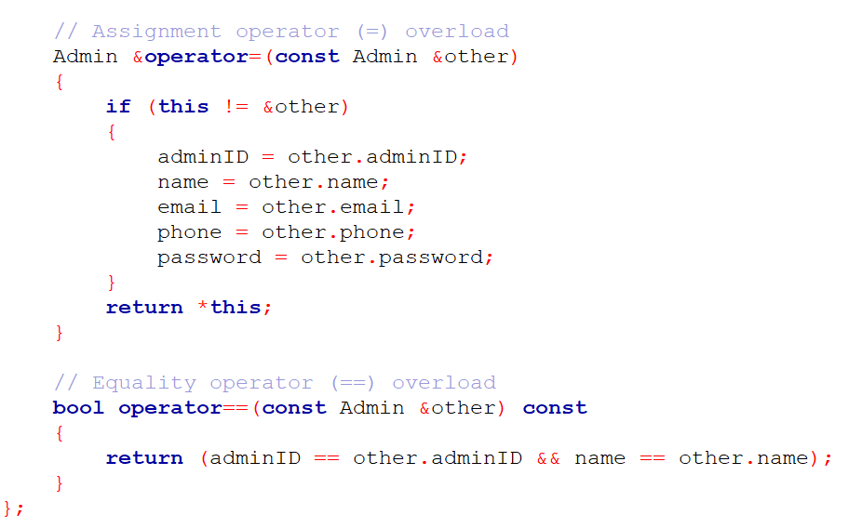
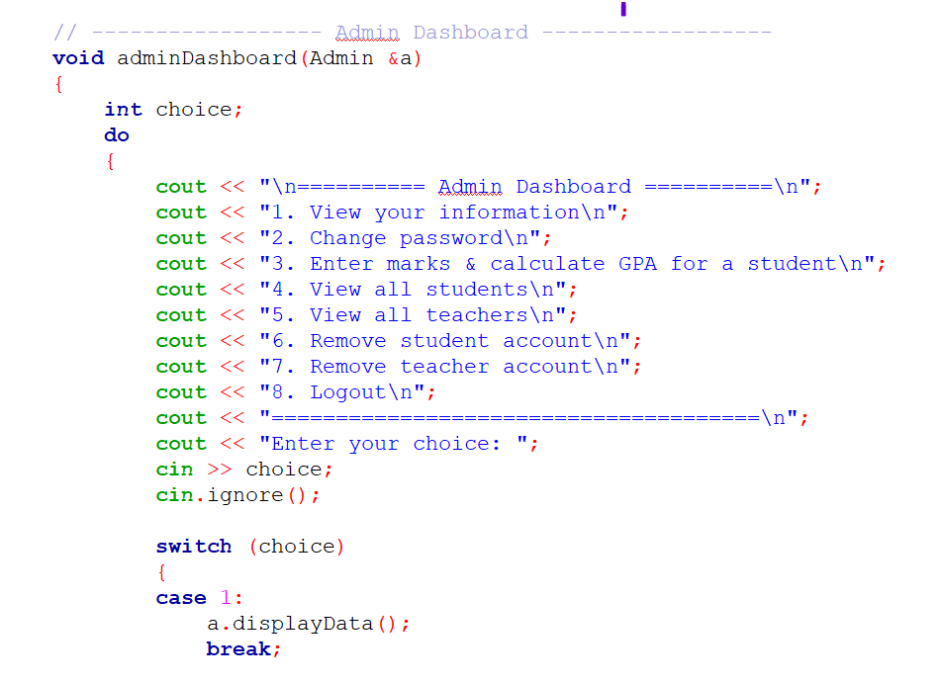

Slide 19
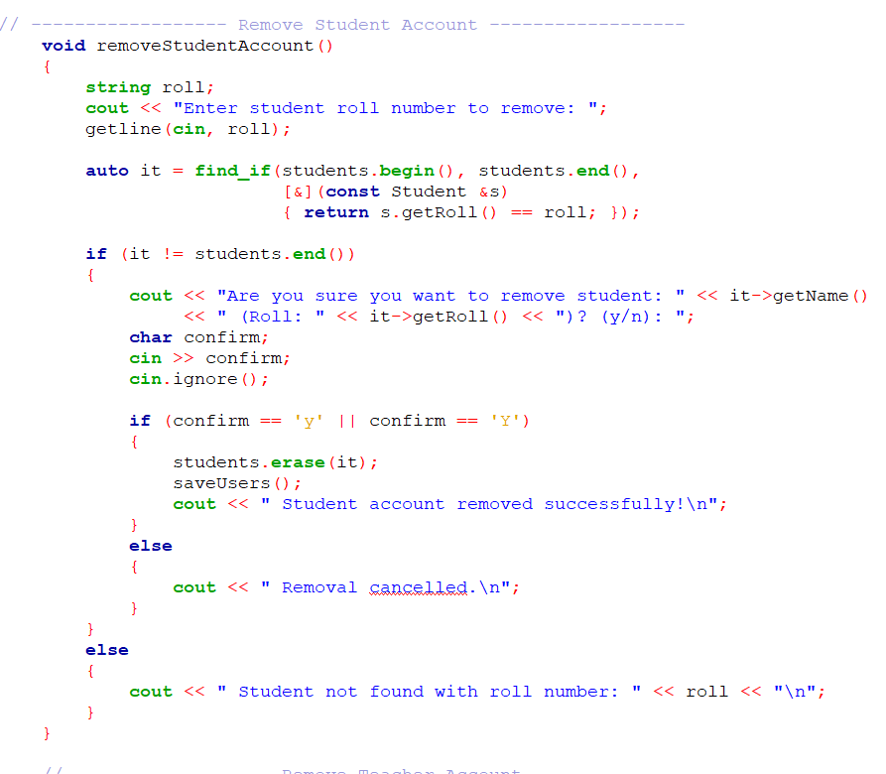
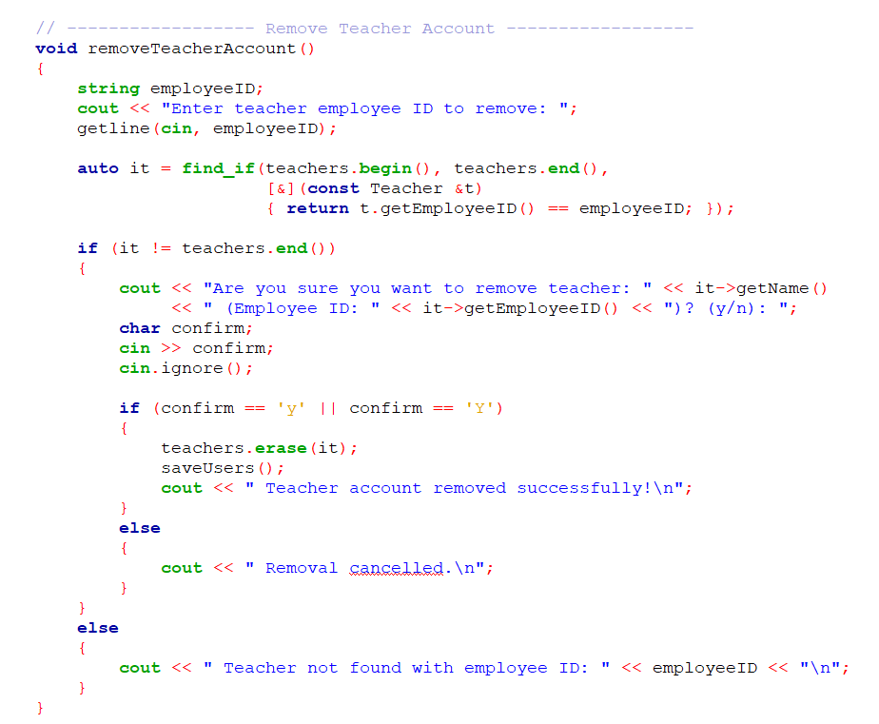
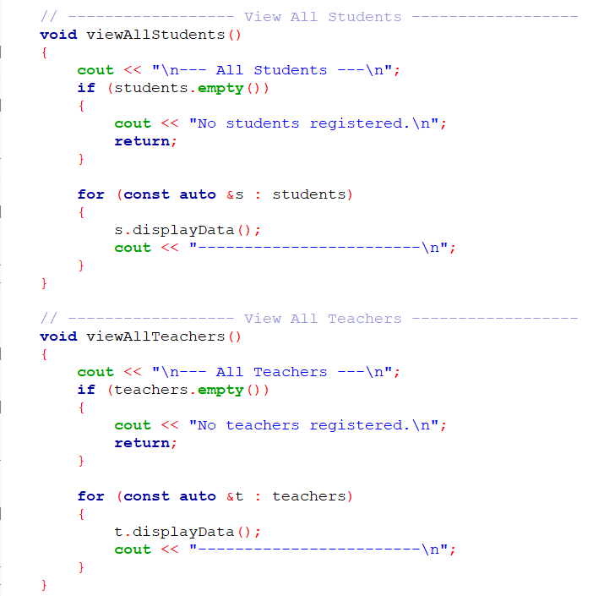

Slide 20

The MainMenu Class
Handles:
Vectors for students, teachers, admins
File names for persistent storage
Functions:
Load and save all users
User registration and login
Role-based dashboard routing
Admin-specific operations

Slide 21






Slide 22
OOP Concepts Used
Encapsulation – Private data with public methods
Inheritance – Student, Teacher, Admin inherit from User
Polymorphism – Virtual functions and operator overloading
Abstraction – Abstract getID() method in User class
File Handling – Save/load users and results
Friend Functions & Operator Overloading – Stream operators and comparison operators

Slide 23
Summary
This project:
Implements a complete Student Management System
Uses file I/O for data persistence
Supports role-based access and operations
Demonstrates OOP principles effectively
Provides a secure and user-friendly console interface

Slide 24
Thank You

